Slide 1
Atomic databases, spectral codes and associated uncertainties
Jelle Kaastra
SRON & Leiden University

Slide 2
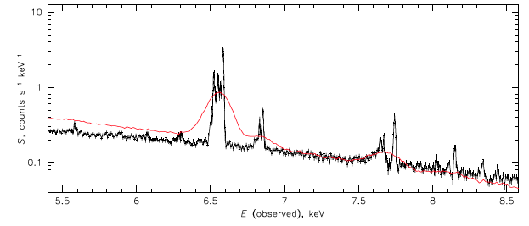
Why care about atomic data?
Suzaku (CCD)
Hitomi (Calorimeter)
We see lines, and:
there is information in these lines!

Slide 3
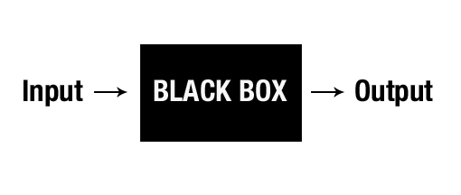

Preference for black box?
You can use models (APEC, SPEX, Chianti, XSTAR, ….) as black boxes
It gives you a temperature, an abundance
But what does it mean?
How accurate is it?
Why do I see residuals?
Help!

Slide 4
What can you learn from a spectrum?
(Electron) temperature (from continuum or lines present)
Ion temperature (from line broadening)
Turbulence (from line broadening)
Velocity fields (from Doppler shifts)
Electron density (from line ratios)
Emission measure n²V (from flux)
Abundances (from relative line intensities)
Age of the plasma (for transient plasmas)
Ionisation process (photons, electrons)
Nonthermal electrons
Dust
Sometimes: magnetic fields
Etc.

Slide 5
Types of plasma
Type determined by role of collisions of ions with:
Electrons (always there, τ<<1 for CIE)
Photons (photoionized plasma, τ~1)
Protons (usually small corrections)
Other ions / atoms (Charge exchange)
Always solve balance ionisation ⬅➔recombination
Sometimes solve balance heating ⬅ ➔ cooling
Sometimes consider transient plasmas

Slide 6
Steps in understanding a spectrum of a plasma and how to calculate a model for it
Basic physical properties:
temperature, density, composition, size, shape, influx, …..
Determine ionisation balance: how many ions of each species
depends on physical conditions
Calculate emitted spectrum
Calculate absorption by the source: can all radiation escape?

Slide 7
Ionisation balance
Plasma type | Ionisation Balances recombination | Heating balances cooling | Time dependent (no balance) | Optical depth
CIE (Collisional Ionisation Equilibrium) | ✓ | ✕ | ✕ | 𝜏=0
PIE (Photo Ionisation Equilibrium) | ✓ | ✓ | ✕ | 𝜏>0
NEI (Non-Equilibrium Ionisation) | ✓ With source term | ✕ | ✓ | 𝜏=0
Transient PIE | ✓ With source term | ? | ✓ | 𝜏>0

Slide 8
Emission components: not everything is Bremsstrahlung! (and not everything is Fe-K….)
Continuum
Bremsstrahlung from all ions, not only hydrogen
Radiative Recombination Continuum (RRC) NB narrow, line-like for PIE plasmas
Two Photon emission
Lines
Can dominate the flux at lower temperatures
Various contributions: excitation, recombination, inner-shell ionisation

Slide 9
Absorption components
Continuum ”edges”
Easy to find with low-resolution instruments
Broad-band
Absorption lines
Much more sensitive to detect low columns of plasma
Needs high-resolution
EXAFS (Extended X-ray Absorption Fine Structure)
Tracer for solid state structure (dust)
Continuum wiggles near absorption edges

Slide 10
Plasma codes & models
Code | Applicable | Notes
Raymond-Smith | CIE | Deprecated, use APEC
APEC/ATOMDB | CIE, NEI, CX
Chianti | CIE | Widely used for Sun
Mekal | CIE, NEI | Deprecated, use SPEX
SPEX | CIE, NEI, PIE, CX
XSTAR | PIE mainly | Evolved from X-ray band
Cloudy | PIE mainly | Evolved from optical/UV
All codes contain atomic data and algorithms to produce spectra
Different techniques:
on the fly or pre-calculated
Original data or approximated data
Not always all processes included
Level of modernity data can differ from code to code and process to process

Slide 11
SPEX plasma code & spectral fitting tool, developed @ SRON since 1972
www.sron.nl/spex
handles X-ray spectra for wide range physical conditions
updates needed & being worked on:
significantly improved, modern atomic data available
New high-resolution spectra from XRISM, Athena need more detail
Complex, computational intensive: ~10 processes, ~500 ions, ~10⁷ spectral lines
Update Fe-L complex: Liyi Gu et al. 2019
Each point is a fit to a group or cluster of galaxies
Suzaku (CCD)
Hitomi (Calorimeter)
O/Fe ratio new/old
Temperature (keV)

Slide 12
Now where are the atomic data and processes?
For full plasma model, need many (12+) atomic processes:
Collisional ionisation
Collisional excitation
Resonant excitation
Dielectronic recombination
Radiative transition probabilities
Auto-ionisation rates
Radiative Recombination rates
Photoionisation cross sections
Escape factors
Line energies
Charge exchange cross sections
Proton excitation
Etc.
Each process has its own intricacies and (atomic) data

Slide 13

Photoionised plasmas
Irradiated plasma
Two balance equations:
Photons:
Photo-ionisation
Heating by photo-electrons
Electrons:
Radiative recombination (electron capture)
Cooling by collisional excitation (followed by line radiation)

Slide 14
Photoionisation equilibrium
Photon / gas density ➔
Radiation/gas pressure ➔

Slide 15
How do calibration uncertainties affect thermal model parameters?

Slide 16
RGS 1-T model with power law effective area error

Slide 17
RGS 1-T model with power law effective area error kT = 4 keV
Parameter | Input value | Fit 1 | Fit 2 | “True” fit
Norm | 10000 | 9964±25 | 10213±28 | 10009±30
T (keV) | 4 | 3.88±0.04 | 2.94±0.05 | 4.01±0.08
C | 1 |  | 0.84±0.07 | 1.04±0.09
N | 1 |  | 0.62±0.09 | 0.81±0.12
O | 1 |  | 0.72±0.02 | 0.99±0.03
Ne | 1 |  | 0.64±0.03 | 1.01±0.05
Mg | 1 |  | 0.67±0.04 | 1.05±0.06
Si | 1 |  | 0.61±0.05 | 0.93±0.07
Fe | 1 |  | 0.56±0.02 | 0.99±0.04
Cstat | 1116±47 | 1582 | 1177 | 1087
Fit 1 not acceptable (too high Cstat)
Fit 2 (free abundances) would be accepted
Strong bias in T (> 1 keV!)
Abundances too low (almost up to 2x)
Errors on parameters underestimated (almost up to2x )

Slide 18
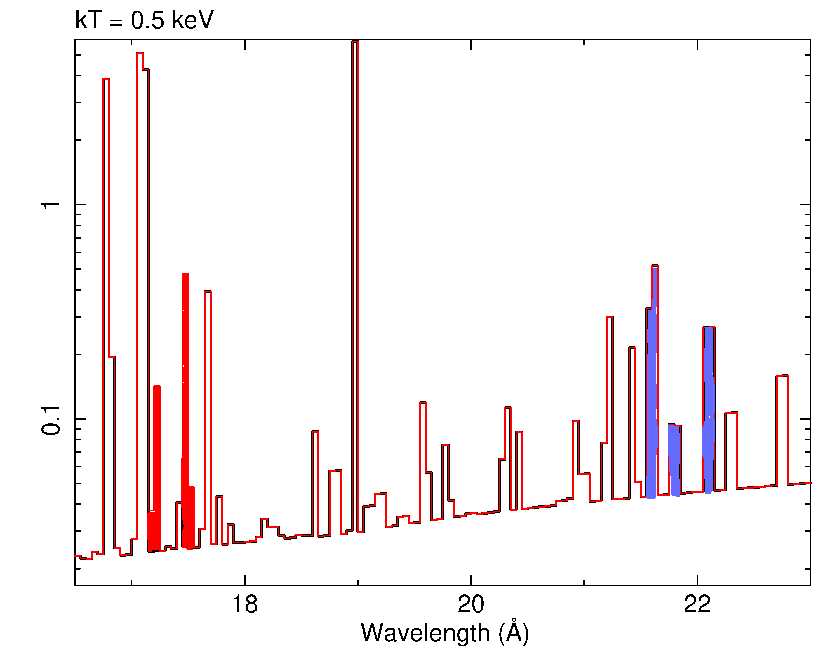
All things can be important
Real example:
“old” (pre-2000) mekal code had typo in Fe XVI lines (10x too strong) [not important for CCD but matters for grating]
For RGS band, Fe XVI “coldest” Fe ion
Line not seen in spectra, but predicted
➔ Make emission measure at low T lower in the model
O VII formed at same temperatures
➔Make O abundance higher
➔Strong bias
Most codes had/have similar “glitches”
Calculation with “old” mekal code
O VII
Seen in data
Fe XVI – not seen

Slide 19
Good match MEG model with RGS data
RGS – model
MEG - model
RGS – model
MEG - model

Slide 20
Example: Hitomi Perseus spectrum
Intricate relation between calibration and thermal models

Slide 21
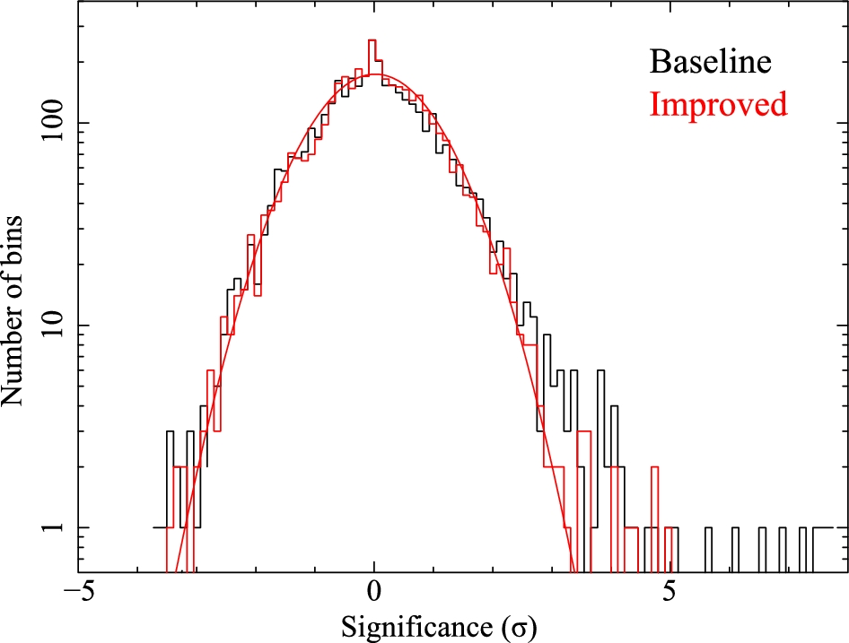
How good are the fits?
Baseline model: 1T
Improved model: multi-T structure
Most residuals consistent with expected statistical distribution
Outliers caused by errors on predicted line intensities

Slide 22
Details thermal models matter (more than calibration uncertainties?)

Slide 23
Atomic data: H-like ions
Si XIV
Differences collision strength 1s-2p transition in H-like Si or Fe
For Si XIV, leads to 30% difference line flux ➔ 30% difference deduced abundance
Fe XXVI

Slide 24
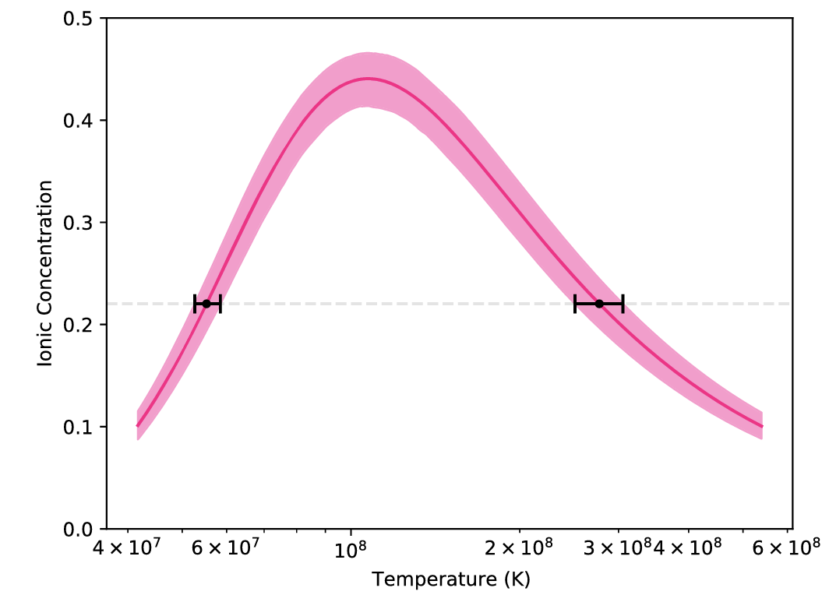
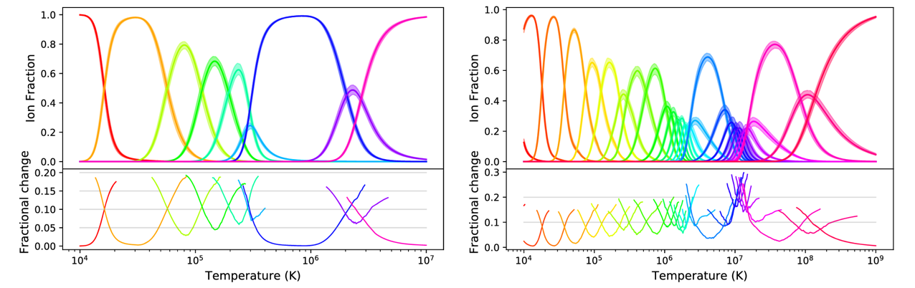
Ionisation equilibrium (Heuer et al. 2021)
Fe XXVI

Slide 25
Extrapolations: take care
Example: Old codes approximated radiative recombination by local power-law
Okay for CIE (dominated by collisional excitation) but:
Large deviations for recombining / ionising plasma when true shape is used (Mao et al. 2016)
Strong consequences for derived O, N abundances in clusters
log rate ➔
T_{max}
log T ➔

Slide 26
Interpolations: take care (Mernier et al.)

Slide 27
Line wavelength accuracies
(from Smith & Brickhouse 2014)

Slide 28
Line profiles

Slide 29
Final note on accuracies
Few quantities calculated up to many digits (energies for H-like ions)
Most quantities uncertain by several %, up to 10-20%
Sometimes larger deviations (often human errors)
Need to validate using independent models
➔APEC (Smith et al.) & SPEX (Kaastra et al.):
Will not merge their codes
Are not competitors
Are friendly colleagues

Slide 30
Conclusions
Atomic data matter
Getting accurate atomic data is not trivial
However, they are needed to avoid biased astrophysical results
Atomic data intimately linked to the models in which they are applied
Try to understand the basics of the models to appreciate your astrophysical results

